Slide 1
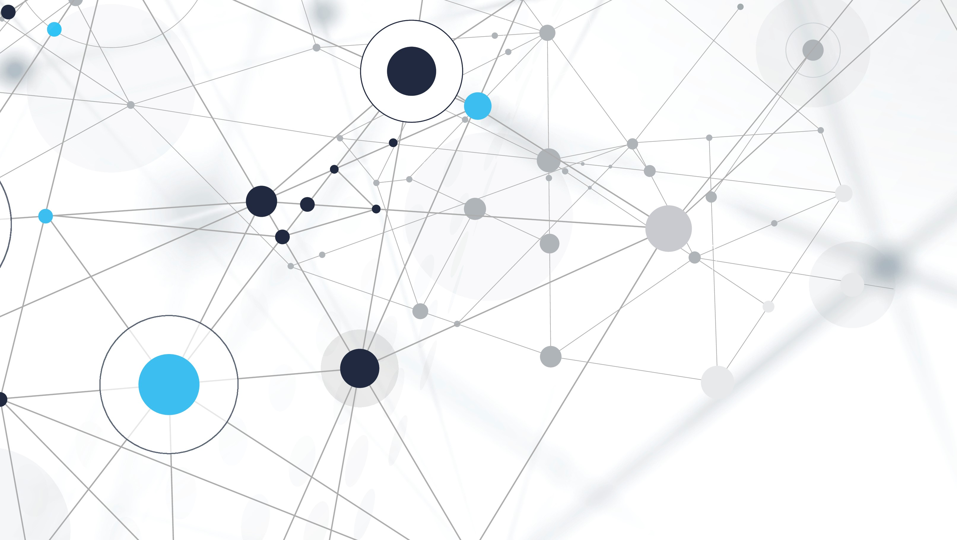
Introduction to Self Driving Cars
Bhavesh Laddagiri

Slide 2
How Does a Self Driving Car Work
Techniques used in building a self driving car
Lane Detection
Object Detection (Traffic Signs, People, etc)
Behavioral Cloning
Kalman Filters
Localization
Planning
Reinforcement Learning
Lidar
And many more…

Slide 3
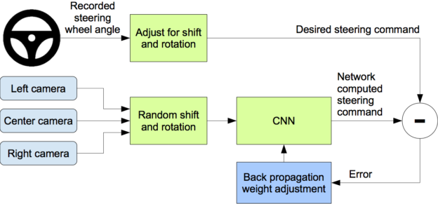
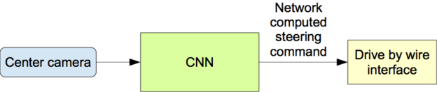
Behavioral cloning
Behavioral Cloning is a supervised learning technique for End to End Self Driving Cars.
Inference
Training
Image Credits: https://devblogs.nvidia.com/deep-learning-self-driving-cars/

Slide 4
Contents
Getting the Driving Data
Load the Data
Data Preprocessing and Augmentations
Randomly choosing between center | left | right and adjusting the steering
Flipping the image horizontally and taking the negative of steering
Adjusting the brightness to lighter or darker
Preprocessing the augmented images by cropping and resizing
Batch Generator
Building the Model
Training
Autonomous Driving

Slide 5
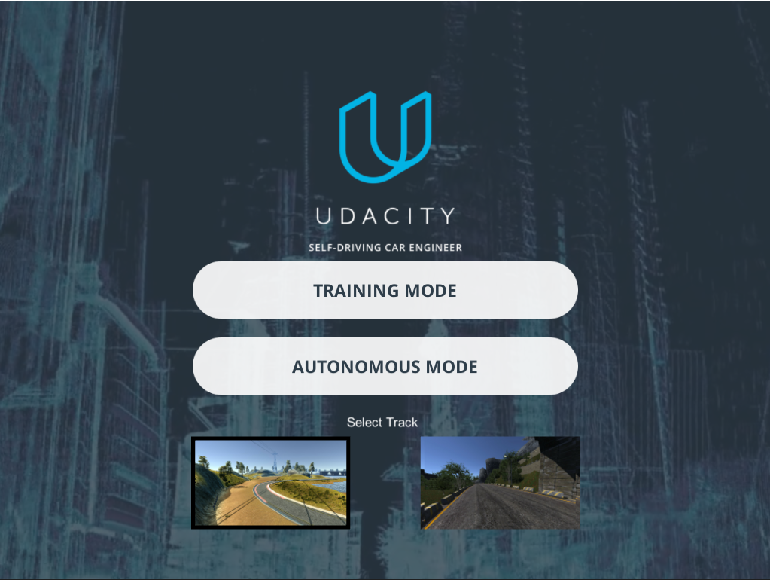
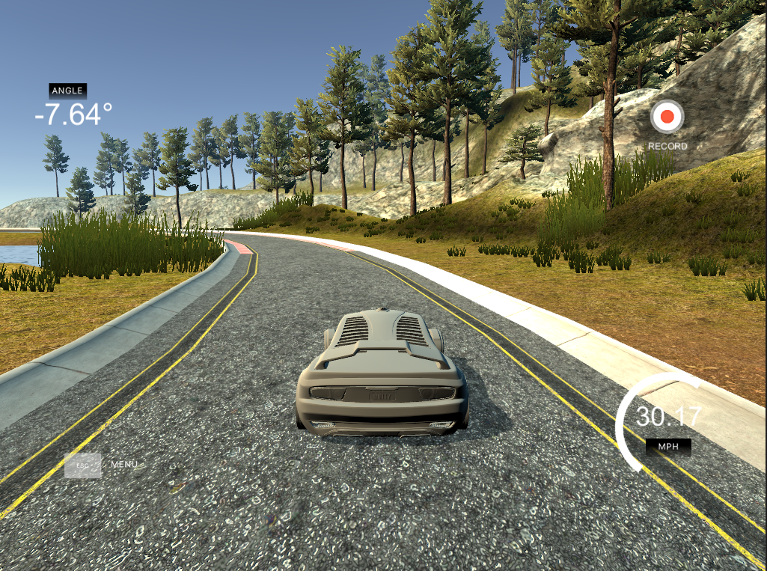
Getting the Data

Slide 6
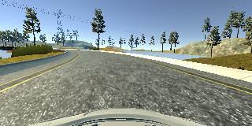
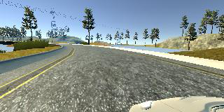
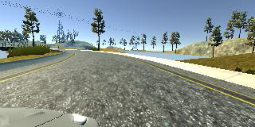
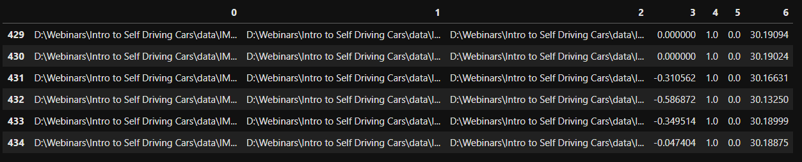
Loading the Data
Center
Left
Right
Steering Angle
-0.586872

Slide 7
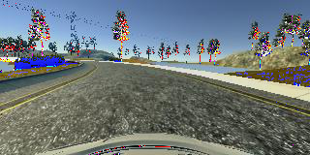
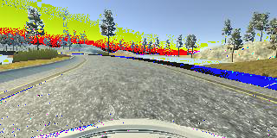
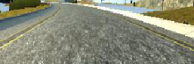
Data Augmentation and Preprocessing
Randomly choosing between, center | left | right
If left is chosen we add an offset to the steering angle ( + 0.3 )
If right is chosen we subtract the offset from the steering angle ( - 0.3 )
Randomly Flipping the Images horizontally
Randomly changing brightness
Preprocessing the image
Cropping the sky and the front of the car
-0.58
-(-0.58) = 0.58

Slide 8
Building the Model
Normalized Input (1/255)
Convolution Layers (Activation of ELU (Exponential Linear Unit))
24 filters, 5x5 kernel size and stride of 2x2
36 filters, 5x5 kernel size and stride of 2x2
48 filters, 5x5 kernel size and stride of 2x2
64 filters, 3x3 kernel size and stride of 1x1
64 filters, 3x3 kernel size and stride of 1x1
Flatten
Fully Connected Layers (Activation of ELU (Exponential Linear Unit))
100 neurons
50 neurons
10 neurons
1 output neuron
Ref: Nvidia https://arxiv.org/abs/1604.07316v1

Slide 9
Thank You
References:
https://devblogs.nvidia.com/deep-learning-self-driving-cars
https://arxiv.org/abs/1604.07316v1
https://github.com/udacity/CarND-Behavioral-Cloning-P3
https://github.com/udacity/self-driving-car-sim
https://github.com/naokishibuya/car-behavioral-cloning

